Slide 1
Hands On DataScience
Oriol Varela

Slide 2
Index
What is Data Science?
Machine learning introduction
Hands on coding
Conclusions

Slide 3
What is Data Science?
Ask the right question
Be sure you have the correct data to answer it

Slide 4
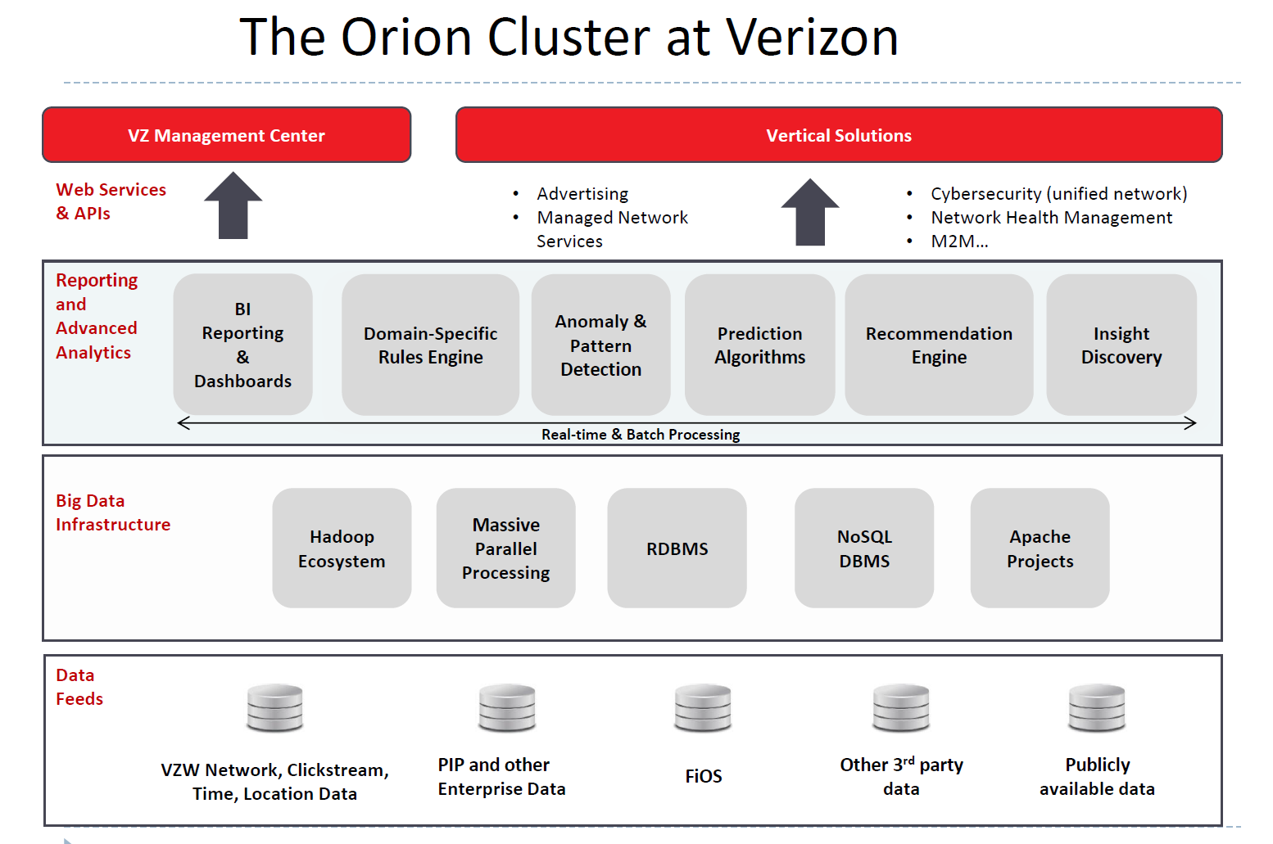

Slide 5
WHAT IS MACHINE LEARNING ?
Traditional programming
Computer
Data
Output
Algorithm

Slide 6
WHAT IS MACHINE LEARNING ?
Machine learning
Computer
Data
Algorithm
Output

Slide 7
MACHINE LEARNING TECHNIQUES
We can separate learning problems into:
Supervised learning: Data is labeled and the algorithms learn to predict the output from the input data.
Classification: samples belong to two or more classes (discrete values) and we want to learn from already labeled data how to predict the class of unlabeled data.
Regression: Desired output consists of one or more continuous variables. We want to predict a specific continuous value.
Unsupervised learning: All data is unlabeled and the algorithms learn to inherent structure from the input data.
Clustering: A clustering problem is where you want to discover the inherent groupings in the data, such as grouping customers by purchasing behavior.
Association: An association rule learning problem is where you want to discover rules that describe large portions of your data, such as people that buy X also tend to buy Y.
Semi-supervised: Some data is labeled but most of it is unlabeled and a mixture of supervised and unsupervised techniques can be used.
Notes:
You are a kid, you see different types of animals, your father tells you that this particular animal is a dog…after him giving you tips few times, you see a new type of dog that you never saw before - you identify it as a dog and not as a cat or a monkey or a potato.
You go bag-packing to a new country, you did know much about it - their food, culture, language etc. However from day 1, you start making sense there, learning to eat new cuisines including what not to eat, find a way to that beach etc.
Example, semi supervised: photo archive where only some of the images are labeled, (e.g. dog, cat, person) and the majority are unlabeled. Many real world machine learning problems fall into this area. This is because it can be expensive or time-consuming to label data as it may require access to domain experts. Whereas unlabeled data is cheap and easy to collect and store.
You can use unsupervised learning techniques to discover and learn the structure in the input variables.

Slide 8
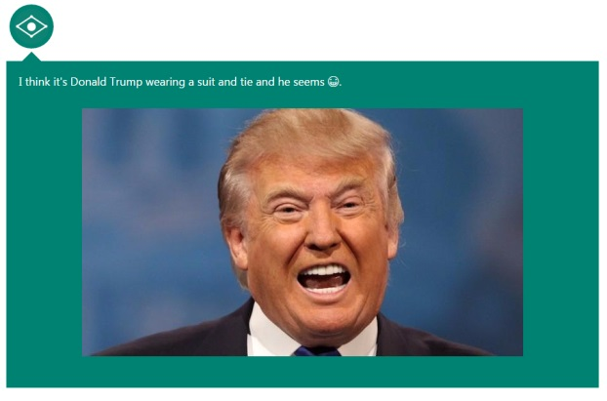
Captionbot.ai

Slide 9
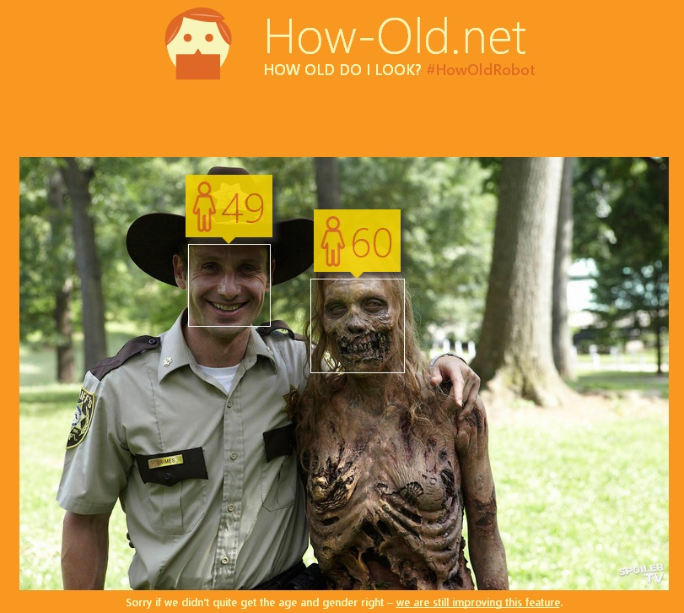
Howold.net

Slide 10
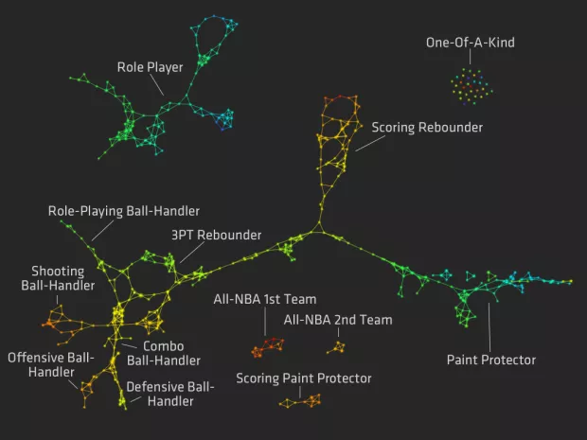
Notes:
https://flowingdata.com/2012/03/21/redefining-nba-basketball-positions/

Slide 11


Slide 12
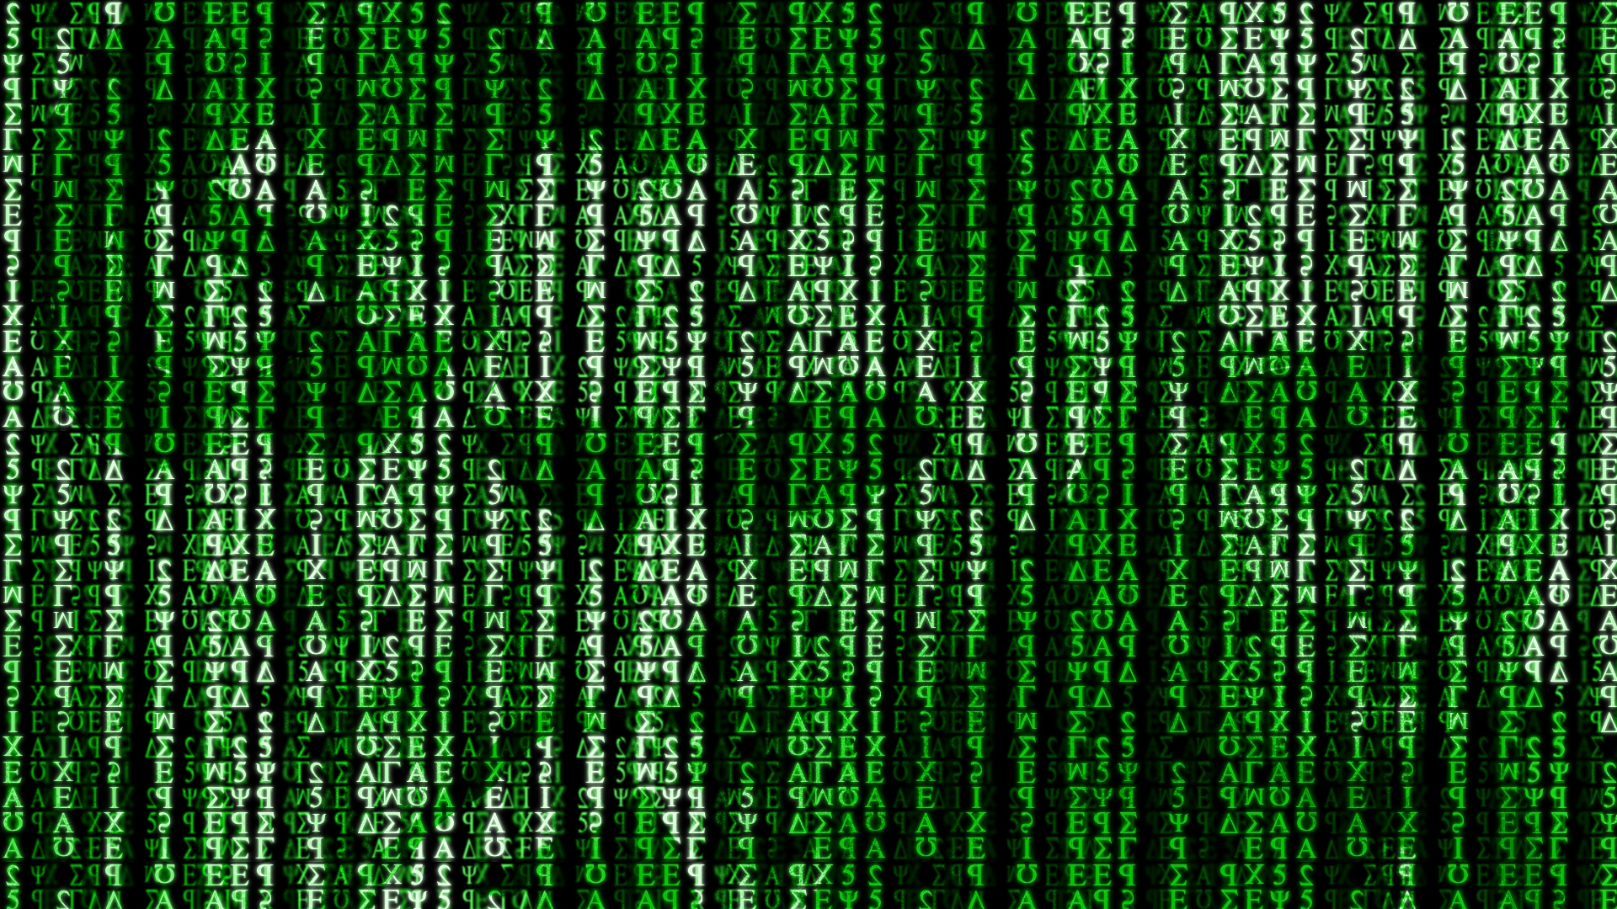
To the code!

Slide 13
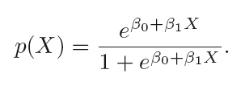
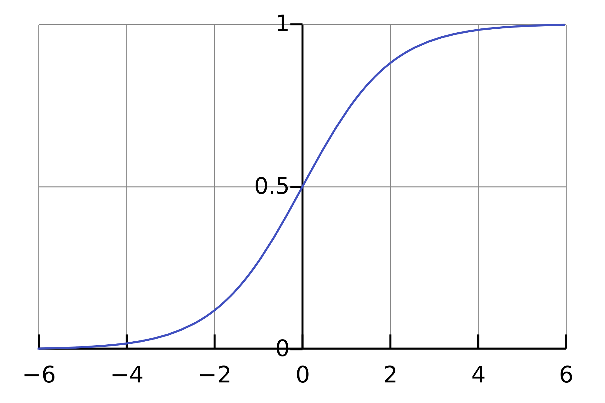
Logistic Regression

Slide 14
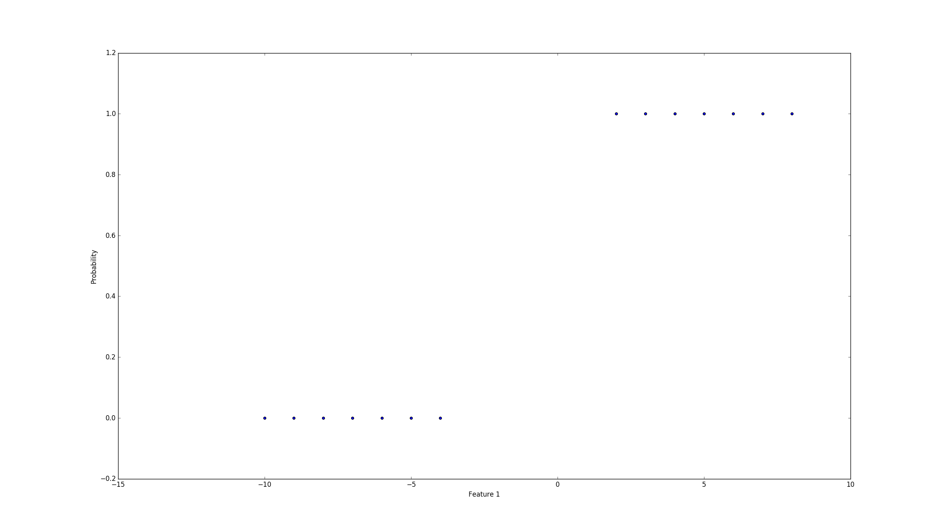
Logistic Regression

Slide 15
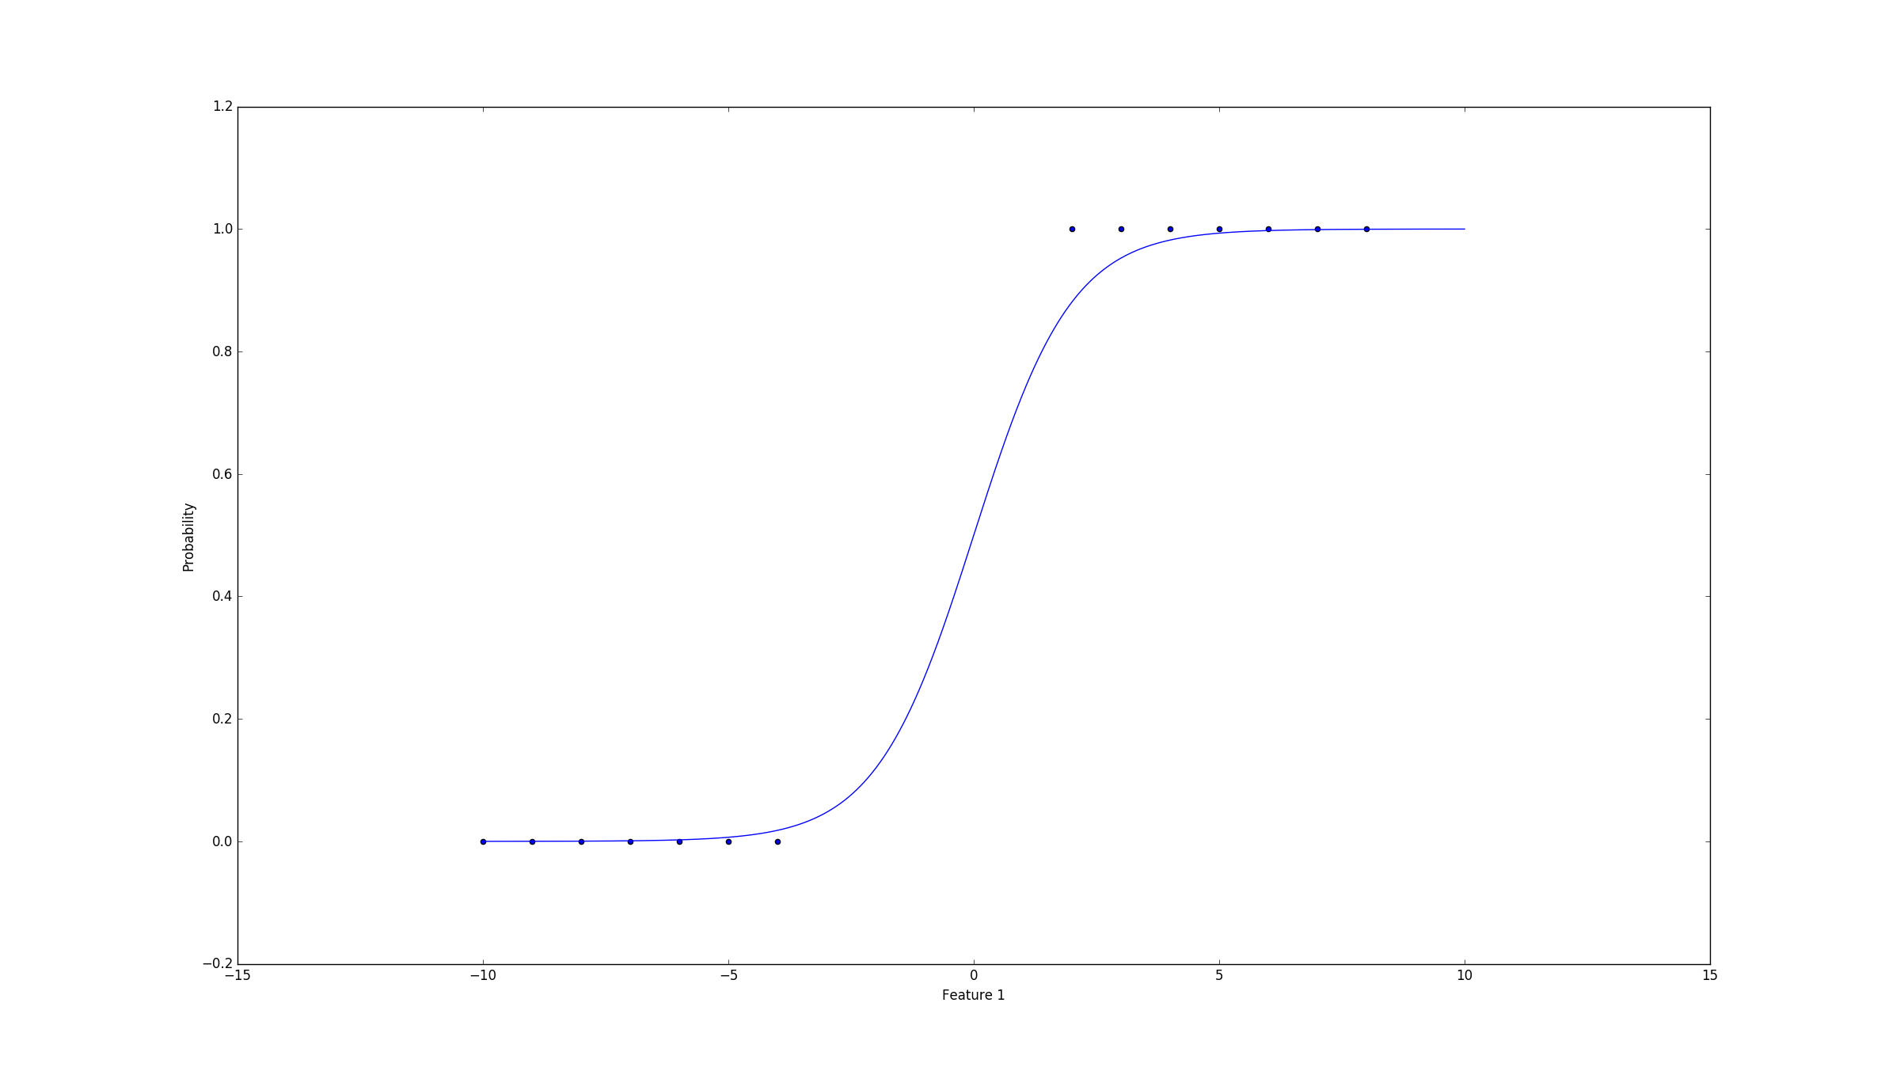
Logistic Regression

Slide 16
Logistic Regression
If you want to more about how to model a logistic regression:
Maximum likelihood
Newton-Raphson Method

Slide 17
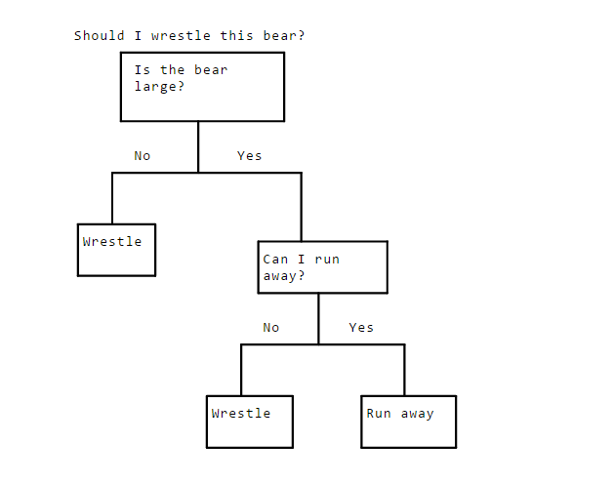
Logistic Regression
Decision trees
Notes:
Decision trees can pick up nonlinear tendencies in the data. The idea behing a decision tree is that we split our data until we'll eventually reach a leaf. The leaf will tell us what value we should predict for. That leaf should be either 1 or 0, we keep splitting until we reach that point

Slide 18
Logistic Regression
How do we programatically know how to split?
We're trying to get to leaves consisting of only 1s or only 0s, each split will need to get us closer to that goal.
When we split, we'll try to separate as many 0s from 1s in the target column as we can. In order to do this, we need a metric for how "together" the different values in the target column are.

Slide 19
Logistic Regression
How do we programatically know how to split?
Mathematics! Entropy! Awesomeness
Entropy refers to disorder. The more "mixed together" 1s and 0s are, the higher the entropy. A dataset consisting of only 1s in the target column would have low entropy.
Entropy comes from information theory. (NOT PHYSICS!)
Notes:
Entropy can also be thought of in terms of information. If we flip a coin where both sides are heads, we know upfront that the result will be heads. Thus, we gain no new information by flipping the coin, so entropy is 0. On the other hand, if the coin has a heads side and a tails side, there's a 50% probability of landing on either. Thus, flipping the coin gives us one bit of information -- which side the coin landed on.

Slide 20
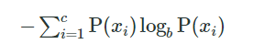
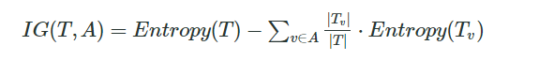
Logistic Regression
How do we programatically know how to split?
Notes:
Basically what we are trying to do is to lower the entropy. We're finding the entropy of each set post-split, weighting it by the number of items in each split, then subtracting from the current entropy. If it's positive, we've lowered entropy with our split. The higher it is, the more we've lowered entropy.

Slide 21
Logistic Regression
Now we can understand random forests:
The problem with decision trees is the overfitting. They perform very good for the train data but not when testing with unknown data.
A random forests is an ensemble model. It combines the predictions of multiple models to create a more accurate final prediction.

Slide 22

Logistic Regression

Slide 23
Logistic Regression
What we are basically doing is building different decision trees:
Different parameters, leafs, max depth…
Different training data (bagging)
Different splitting methods
- All combined give a better result. On the other hand it takes more time to train. And it is more expensive to compute
Notes:
Let’s say we have two programmers with different backgrounds. If you give both of them a project, since they both have different knowledge and experience, they'll both approach it in slightly different ways. They may both produce code that achieves the same result, but one may run faster in certain areas. The other may have a better interface. Even though both of them have about the same talent level, because they approach the problem differently, their solutions are stronger in different areas. If we combine the best parts of both of their projects, we'll end up with a stronger combined project.

